Slide 1
OENG1118 Sustainable engineering practice and design
Week 1

Slide 2
Outline
History
Definition of sustainable development
Reasons for unsustainability
Opportunity of sustainability
Engineering + sustainable development

Slide 3
Introduction to sustainability

Slide 4
History
1972
UN Stockholm Conference on the Human Environment (UNEP 1972)
Addressed (1) decline of ecosystem resilience, and (2) increasing global inequality
113 nations
(Smith et al. 2007; UNEP 1972)
Notes:
Smith, M., Hargroves, K., Desha, C. and Palousis, N. 2007, Engineering Sustainable Solutions Program: Critical Literacies Portfolio - Principles and Practices in Sustainable Development for the Engineering and Built Environment Professions, Unit 1 - Redefining Roles, Lecture 1: The Critical Role of Engineering, The Natural Edge Project, Australia. https://research.qut.edu.au/tnep/curriculum/principles-and-practices-in-sustainable-development/
UNEP 1972, Report Of The United Nations Conference On The Human Environment, UNEP, Paris. http://www.un-documents.net/unche.htm

Slide 5
History
Early 1980s
Progress had lost momentum
UN Commission on Environment and Development (Brundtland Commission)
Produce a consensus document on sustainable development (Brundtland 1987)
1987
Consensus document published as Our Common Future
(Smith et al. 2007; Brundtland 1987)
Notes:
Smith, M., Hargroves, K., Desha, C. and Palousis, N. 2007, Engineering Sustainable Solutions Program: Critical Literacies Portfolio - Principles and Practices in Sustainable Development for the Engineering and Built Environment Professions, Unit 1 - Redefining Roles, Lecture 1: The Critical Role of Engineering, The Natural Edge Project, Australia. https://research.qut.edu.au/tnep/curriculum/principles-and-practices-in-sustainable-development/
Brundtland, G. (ed.) 1987, Our Common Future: The World Commission on Environment and Development, Oxford University Press, Oxford.

Slide 6
History
1992
United Nations Conference on Environment and Development, Rio de Janeiro, Brazil
170 nations
Created Agenda 21 (UNCED 1992), a blueprint of how to achieve sustainable development globally
Chapter 31 covers the role of scientists and technologists (engineers)
(Smith et al. 2007; UNCED 1992)
Notes:
Smith, M., Hargroves, K., Desha, C. and Palousis, N. 2007, Engineering Sustainable Solutions Program: Critical Literacies Portfolio - Principles and Practices in Sustainable Development for the Engineering and Built Environment Professions, Unit 1 - Redefining Roles, Lecture 1: The Critical Role of Engineering, The Natural Edge Project, Australia. https://research.qut.edu.au/tnep/curriculum/principles-and-practices-in-sustainable-development/
UNCED 1992, Agenda 21: United Nations Conference on the Environment and Development, UNCED, New York, chap 31. https://sustainabledevelopment.un.org/outcomedocuments/agenda21

Slide 7
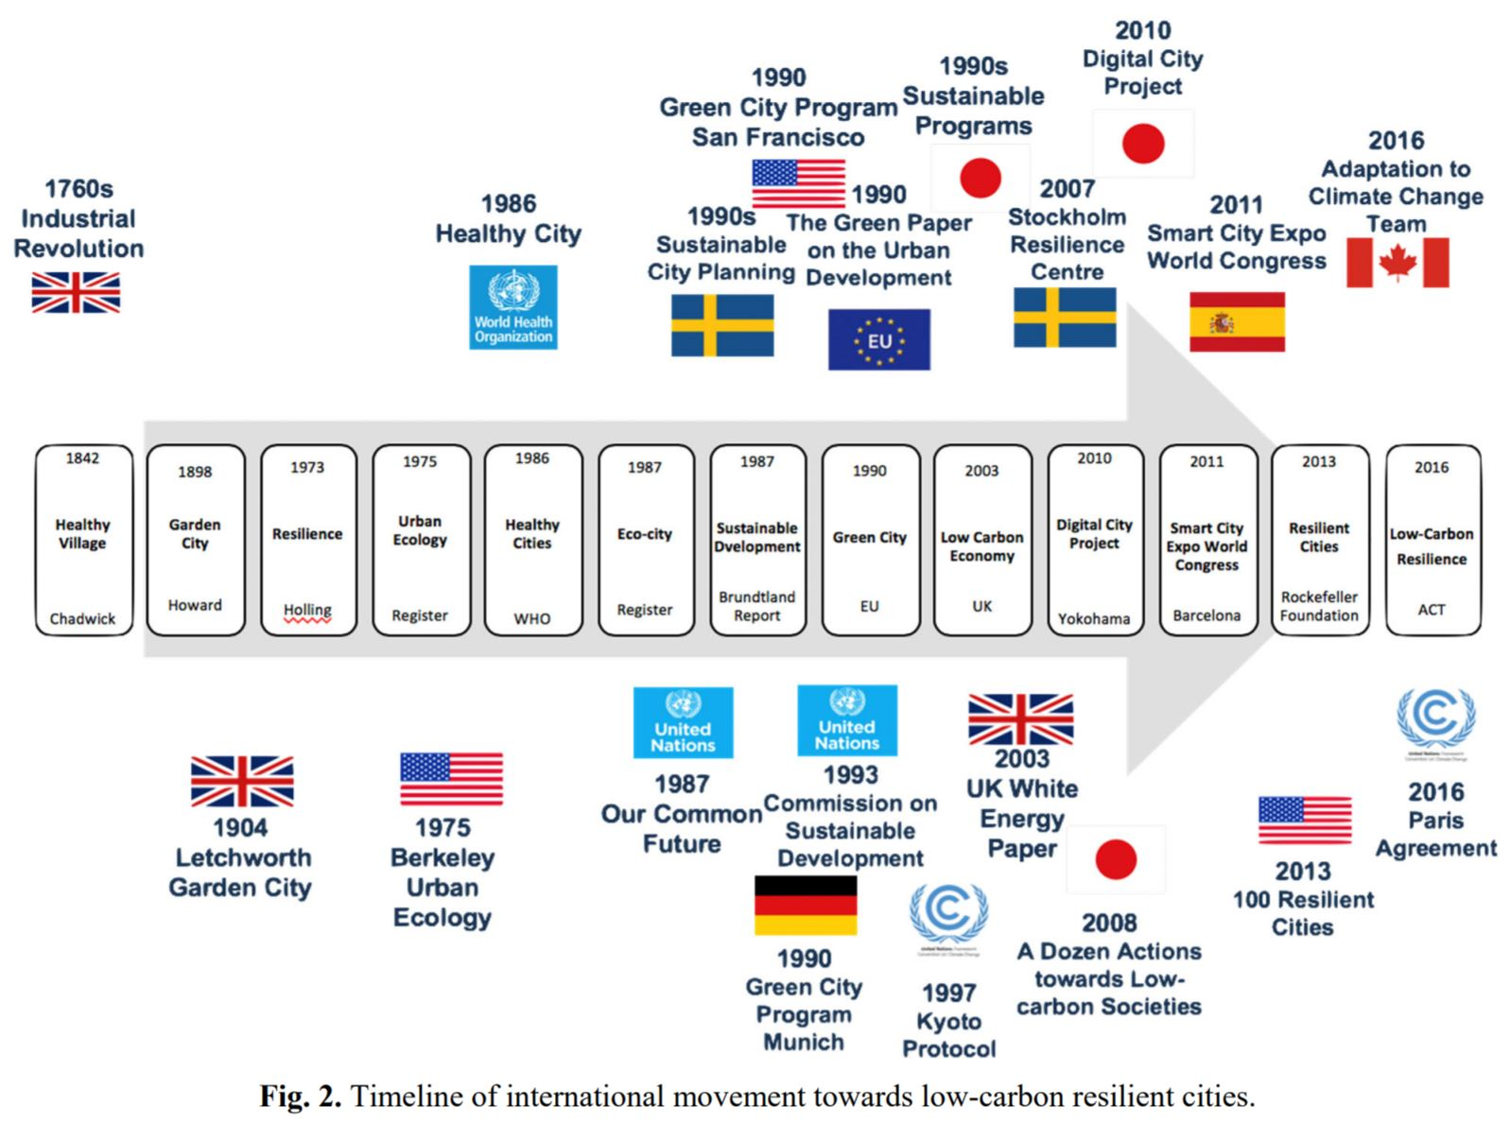
History
Low-carbon resilient cities
(He et al. 2020)
Notes:
Figure: Timeline of international movement towards low-carbon resilient cities.
He, X., Lin, M., Chen, T.L., Lue, B., Tseng, P.C., Cao, W. and Chiang, P.C. 2020, ‘Implementation Plan for Low-carbon Resilient City towards Sustainable Development Goals: Challenges and Perspectives’, Aerosol and Air Quality Research, vol. 20, no. 3, pp. 444-464.

Slide 8
Definition of sustainable development
Development that meets the needs of the present without compromising the ability of future generations to meet their own needs. Brundtland (1987)
Development that:
genuinely sustains and improves economic, social and environmental wellbeing
no major trade offs, locally and globally, now and in the future.
Notes:
Brundtland, G. (ed.) 1987, Our Common Future: The World Commission on Environment and Development, Oxford University Press, Oxford.

Slide 9
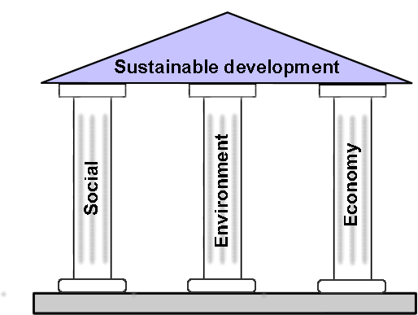
Triple bottom line
Success require all three pillars

Slide 10
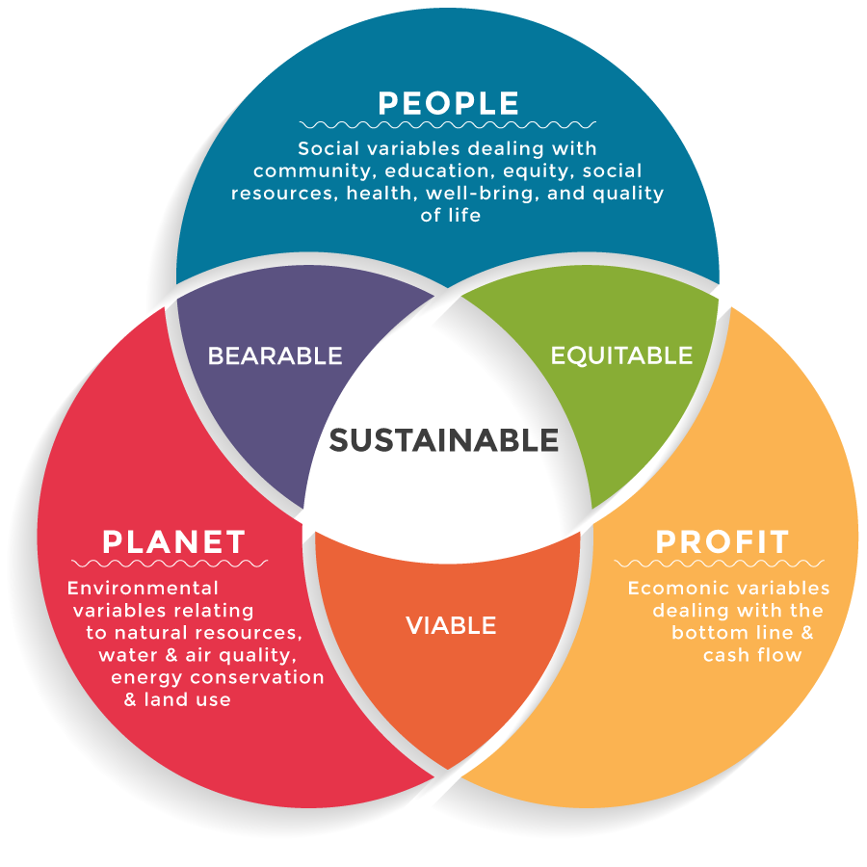
Profit, people and planet
The three Ps
CSR Ambassadors, Triple bottom line

Slide 11
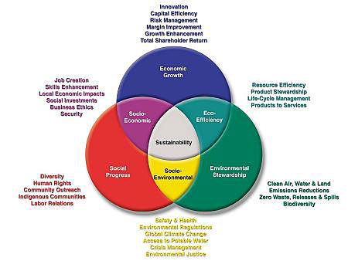
Profit, people and planet
The three Ps
Espinosa 2016, Traditional Models: Hybrid and Triple Bottom Line Organizations

Slide 12
Reasons for unsustainability
Lack of perceived value of ecosystems, biodiversity, natural resources, and social wellbeing in classical economics
Short-term market pressures for business profits
Lack of market incentives for innovation to achieve sustainable technologies and practices, while government continues to subsidise existing polluting industries
The short term political cycle of four years tends to provide little reward for long term thinking and planning
(Smith et al. 2007)
Notes:
Smith, M., Hargroves, K., Desha, C. and Palousis, N. 2007, Engineering Sustainable Solutions Program: Critical Literacies Portfolio - Introduction to Sustainable Development for Engineering and Built Environment Professionals, Unit 1 - A New Perspective, Lecture 2: What has led to a lack of Sustainability?, The Natural Edge Project, Australia. https://research.qut.edu.au/tnep/curriculum/critical-literacies/

Slide 13
Reasons for unsustainability
Lack of capacity building of professionals, such as engineers, architects, and accountants in how to achieve sustainable development
Lack of information for the consumer, such as independent trustworthy labelling, to determine what products are approaching sustainability
Lack of collaboration between various groups actively seeking sustainable outcomes
Lack of partnerships amongst the peak bodies of society to help build the political will for sustainable development
(Smith et al. 2007)
Notes:
Smith, M., Hargroves, K., Desha, C. and Palousis, N. 2007, Engineering Sustainable Solutions Program: Critical Literacies Portfolio - Introduction to Sustainable Development for Engineering and Built Environment Professionals, Unit 1 - A New Perspective, Lecture 2: What has led to a lack of Sustainability?, The Natural Edge Project, Australia. https://research.qut.edu.au/tnep/curriculum/critical-literacies/

Slide 14
Opportunity of sustainability
Innovations to minimise economic costs are approaching their limits
Environmental and social development offer new opportunities for innovation
It’s easier to make a new, big improvements in environmental and social performance than in economic performance
We need to minimise trade offs

Slide 15
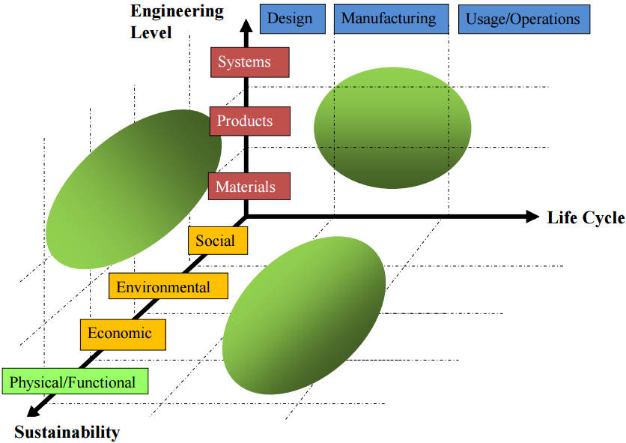
Engineering + sustainable development
End-of-life
Design for:
function
sustainability

Slide 16
Thanks!

